Slide 1
Item 8.4(1)/2 – Amendments to the Manual on the WIPPS (WMO-No. 485) for
climate prediction
Third Session of the Infrastructure Commission
(INFCOM-3, 15-19 April 2024)
David RICHARDSON / Chair SC-ESMP
17 April 2024

Slide 2
Doc.8.4(1) Amendments to the Manual on WIPPS
THREE draft Recommendations
Draft Recommendation 8.4(1)/1 – for weather prediction
General WIPPS
Global/Limited-area deterministic/ensemble NWP
Draft Recommendation 8.4(1)/2 – for climate prediction
Sub-seasonal forecasts, Long-range prediction
Annual to decadal prediction, global climate reanalysis
Draft Recommendation 8.4(1)/3 – for water and related environmental prediction
Nuclear/non-nuclear environmental emergency response
Marine emergency response, Global storm surge prediction
Atmospheric sand and dust storm forecasts, Vegetation fire and smoke pollution forecasts

Slide 3
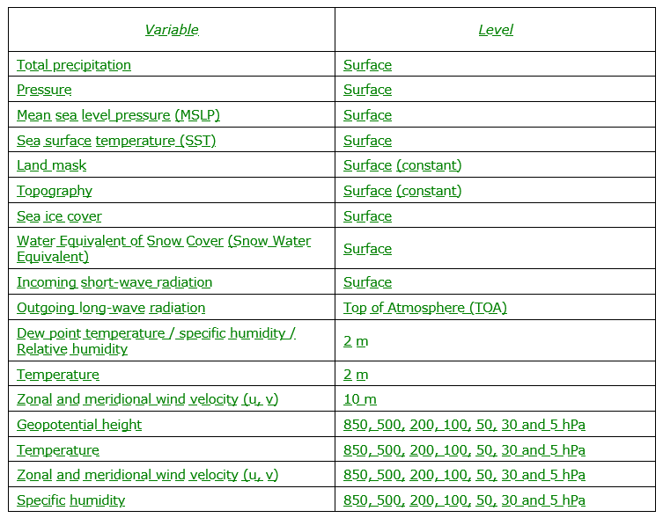
Doc.8.4(1) Amendments to the Manual on WIPPS Draft Recommendation 8.4(1)/2 – for climate prediction
Develop the functions and products of two new types of WIPPS activities regarding global climate reanalysis and coordination of assessment of multiple climate reanalysis - Annex 1
Centre for coordination of assessment of multiple climate reanalysis
Centre for Global Climate Reanalysis (GCR)
Mandatory functions
Collect an agreed set of mandatory products from GCR centres
Interpolate the collected products onto a common horizontal grid, generate climatology and make them available
Provide a set of graphical products
Make a set of tools to visualize the products
Recommended functions
Define and provide common evaluation metrics to compare
etc…

Slide 4
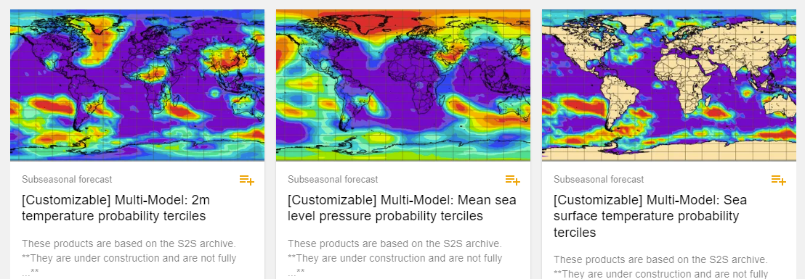
Doc.8.4(1) Amendments to the Manual on WIPPS Draft Recommendation 8.4(1)/2 – for climate prediction
Introduce the concept of the ‘the contributing centre’ to the WIPPS activity of coordination of multi-model ensembles for sub-seasonal forecasts (LC-SSFMME) - Annex 3
Remove password protection for downloading digital products from LC-LRFMME and provide snow water equivalent and other variables as recommended products -Annex5

Slide 5
Doc.8.4(1) Amendments to the Manual on WIPPS Draft Recommendation 8.4(1)/2 – for climate prediction
Introduce the provision of Global Annual to Decadal Climate Update (GADCU) as a mandatory function of lead centre for conducting the coordination of annual to decadal climate prediction (LC-ADCP) - Annex 6
Rearrange the contents structure of WIPPS activities (global numerical sub-seasonal forecasts, global numerical long-range prediction, coordination of multi-model ensembles for sub-seasonal forecasts, and coordination of multi-model ensemble prediction for long-range forecasts) - Annexes 2, 3, 4, and 5

Slide 6
Doc.8.4(1) Amendments to the Manual on WIPPS Draft Recommendation 8.4(1)/2 – for climate prediction
Confirm the capabilities of centres applying for the designation of the following WIPPS centres to be officially designated - Annex 7:
Centres for conducting global numerical sub‑seasonal forecasts: Brazil (Centro de Previsão de Tempo e Estudos Climáticos (CPTEC)), China, Japan and Russia,
Centres for conducting the global climate reanalysis: USA (National Aeronautics and Space Administration (NASA)) and European Centre for Medium-Range Weather Forecasts (ECMWF),
Lead Centre for conducting coordination of assessment of multiple climate reanalysis: ECMWF
RCC Network for the Arctic (ArcRCC-Network)
Change the names of WIPPS activities:
Global numerical sub‑seasonal forecasts ⇒ global sub‑seasonal prediction,
Global numerical long-range prediction ⇒ global seasonal prediction
Inclusion of information regarding the linkage of the Climate Service Information System (CSIS) to the WIPPS in the Manual on the WIPPS - Annex 8

Slide 7
draft Recommendation 8.4(1)/2
Contribution from Members
WiP [14 Apr 2024] – China; USA; Hong Kong, China;
Draft Recommendation – China
Noting further that China submitted the application for a Centre conducting global climate reanalysis, [China]

Slide 8
draft Recommendation 8.4(1)/2
Annex 1 – USA
2.2.1.x Global Climate Reanalysis
2.2.1.x.1 Centres conducting global climate reanalysis (GCR) shall:
(a) Produce global climate reanalyses at the surface, near-surface and throughout the atmosphere;
(b) All reanalysis products (Appendix A) must be updated to include the previous month within 60 days for the end of current month; [U.S.A.]
(b) Update all reanalysis products listed in Appendix A to include the previous month within 60 days of the end of the current month,
2.2.2.x Coordination of assessment of multiple climate reanalysis
2.2.2.x.1 Centre(s) conducting the assessment of multiple climate reanalyses (Lead Centre(s) for Global Climate Reanalysis) shall:
(g) All reanalysis products (Appendix XX) must be updated to include the previous month within 90 days for the end of current month; [U.S.A.] (g) Update all reanalysis products listed in Appendix A to include the previous month within 90 days for the end of current month;
(h) Ensure all products cover at least the most recent WMO climatological reference period. [U.S.A.]

Slide 9
draft Recommendation 8.4(1)/2
Annex 3 – Hong Kong, China
2.2.2.2 Coordination of multi‑model ensembles for sub‑seasonal forecasts
Centre(s) coordinating SSF multi‑model ensembles (Lead Centre(s) for SSFMME) shall:
(ec) Redistribute contributing centre digital products forecast data as describedlisted in Appendix 2.2.4443 [Hong Kong, China] for those GPCs-SSF contributing centres [Hong Kong, China] that allow it, as described in Appendix 2.2.44 [Hong Kong, China];
Appendix 2.2.43. Minimum information to be available from the Lead Centre(s) for sub‑seasonal forecast multi‑model ensembles
Global Producing Centre Digital products
Global fields of forecast and hindcast as supplied by GPCs‑SSF, including (for GPCs that allow redistribution of their digital data) dDaily fields mean global field of forecast variables from contributing centres from for individual forecasts ensemble members for at least each of the four weeks following the forecast initialization date: [Hong Kong, China]

Slide 10
Thank you.
^{wmo.int}

